Slide 1
Lab 7: Phylogenetics III – Bayesian Methods and MCMC
Slides stolen shamelessly from Steve Mussmann, Jeff Silberman, and Jeremy Beaulieu

Slide 2

ML: Searches tree space to maximize the quantity:
$$L=P\left(D | M\right)$$

Slide 3
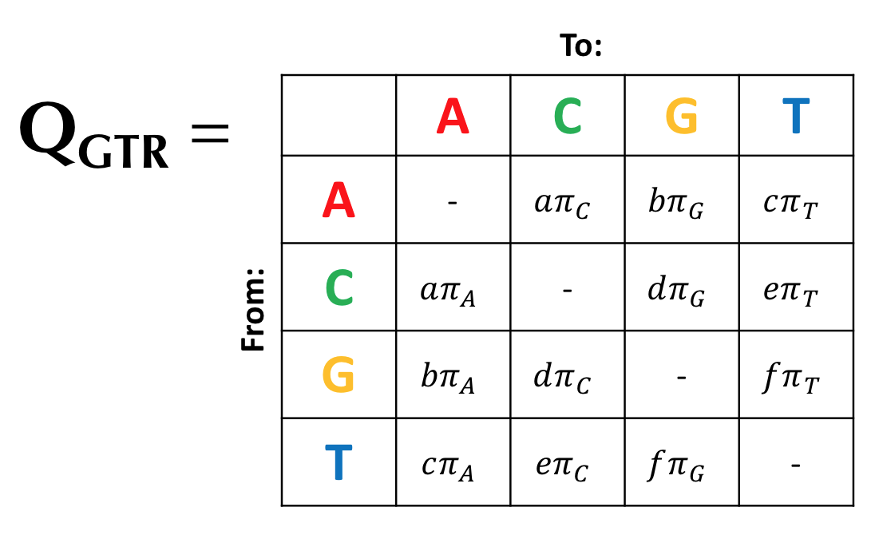
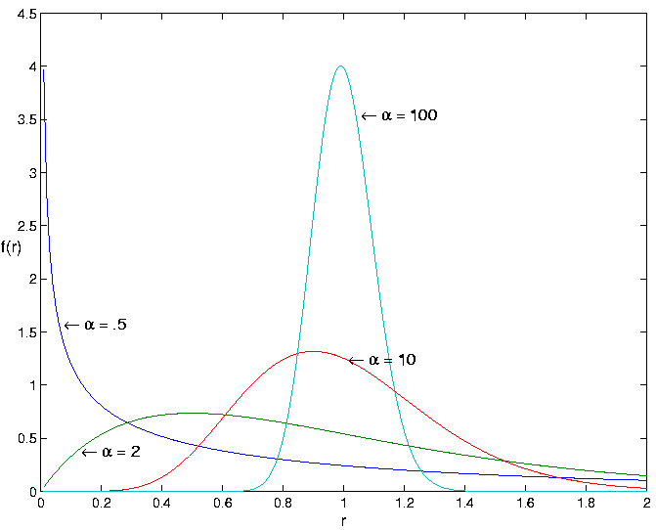
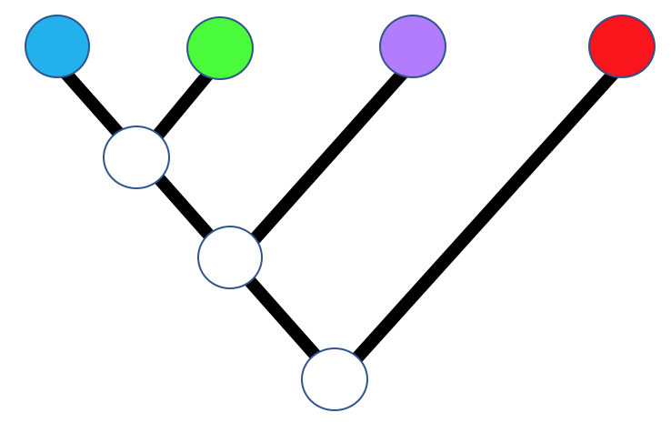
ML: Searches tree space to maximize the quantity:
$$L=P\left(D | M\right)$$

Slide 4
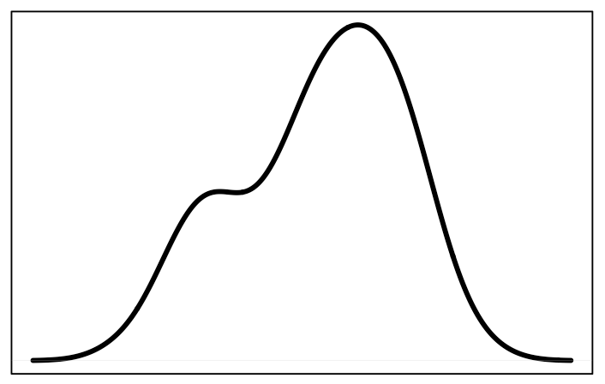
ML gives a point estimate
Maximum Likelihood Estimate
Frequency
Tree score

Slide 5
ML gives a point estimate
Maximum Likelihood Estimate
Frequency
Tree score
What about the variance around that estimate?

Slide 6
Thomas Bayes: OG (1701-1761)
Invented new branch of statistics in 1740s, and never published it (published posthumously in 1764)

Slide 7
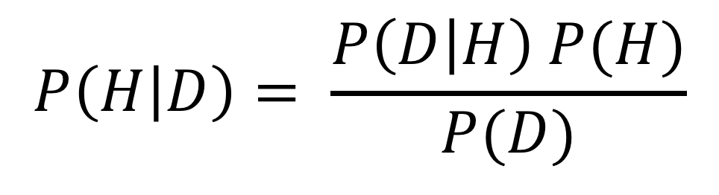
Bayes’ Theorem
$$P\left(H | D\right)= \frac{P\left(D | H\right) P(H)}{P(D)}$$

Slide 8
$$P\left(H | D\right)= \frac{P\left(D | H\right) P(H)}{P(D)}$$
“Posterior probability”: Probability of hypothesis (i.e. tree, model) given our data, and prior assumptions

Slide 9
“Likelihood”: Same as before, probability of the hypothesis producing our data
$$P\left(H | D\right)= \frac{P\left(D | H\right) P(H)}{P(D)}$$

Slide 10
“Prior probability”: Probability of our hypothesis before observing any data. Factor’s in preconceived beliefs about the likelihood of different hypotheses
$$P\left(H | D\right)= \frac{P\left(D | H\right) P(H)}{P(D)}$$

Slide 11
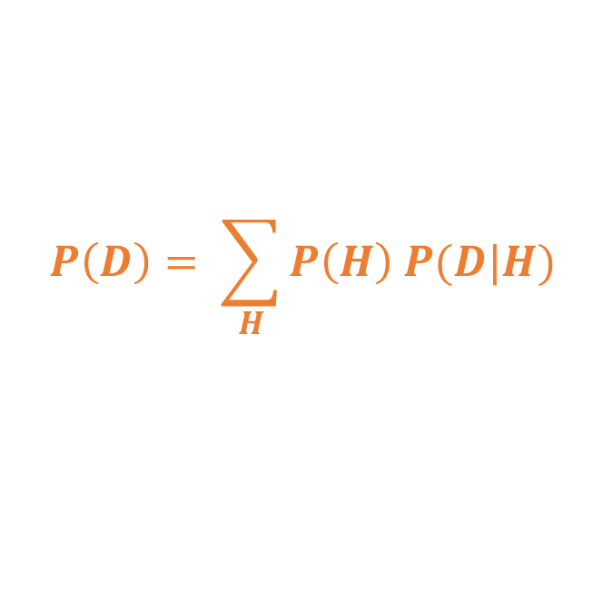
$$P\left(H | D\right)= \frac{P\left(D | H\right) P(H)}{P(D)}$$
“Marginal likelihood”: Normalizing constant to make sure the posterior sums to 1. Takes the form:
$$P\left(D\right)= \sum_{H}{P\left(H\right) P(D|H)}$$

Slide 12
Important concepts
Prior probability: Probability of an event before considering the data
What do we know about how branch lengths are distributed?
What do we know about mutations rates?
How are speciation/extinction rates distributed?

Slide 13
Important concepts
Prior probability: Probability of an event before considering the data
What do we know about how branch lengths are distributed?
What do we know about mutations rates?
How are speciation/extinction rates distributed?
Posterior probability: Probability of an event after taking data and priors into consideration
Given our prior expectations, and the likelihood of our data given the hypothesis, what is the probability of the hypothesis?

Slide 14
Bayesian stats example
Let’s say you’ve tested positive for some imaginary disease. What is the probability you have the disease, given:
0.1% of people have the disease
1% false positive rate of the test

Slide 15
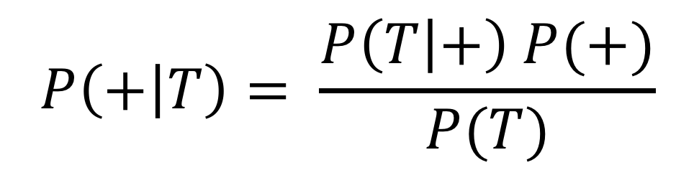
Bayesian stats example
What we want: Probability of having the disease (+), given that you tested positive (T)
$$P\left(+ | T\right)= \frac{P\left(T | +\right) P(+)}{P(T)}$$

Slide 16
Bayesian stats example
Probability of testing positive, given that you are actually positive (in other words: What is the true positive rate of the test?)
$$P\left(+ | T\right)= \frac{P\left(T | +\right) P(+)}{P(T)}$$
The test has a 1% false positive rate. So, we assume the test has a 99% true positive rate.

Slide 17
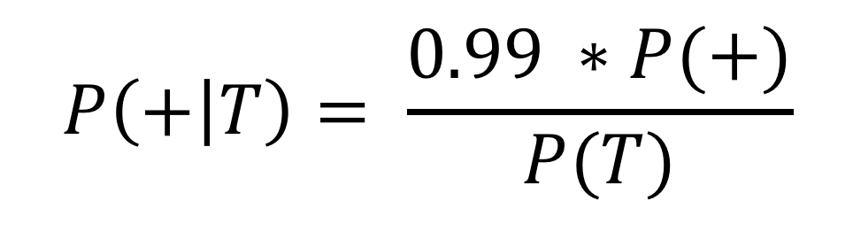
Bayesian stats example
Probability of testing positive, given that you are actually positive (in other words: What is the true positive rate of the test?)
$$P\left(+ | T\right)= \frac{0.99 ∗P(+)}{P(T)}$$
What we know: The test has a 1% false positive rate. So, we assume the test has a 99% true positive rate.

Slide 18
Bayesian stats example
Probability of having the disease, without considering the test results (this is the prior probability!)
$$P\left(+ | T\right)= \frac{0.99 ∗P(+)}{P(T)}$$
What we know: 0.1% of the population has the disease.

Slide 19
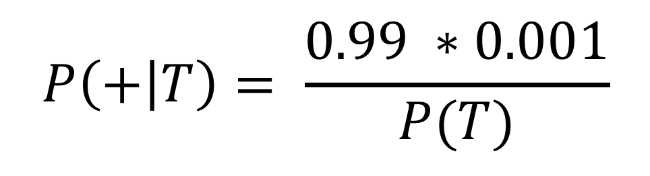
Bayesian stats example
Probability of having the disease, without considering the test results (this is the prior probability!)
$$P\left(+ | T\right)= \frac{0.99 ∗0.001}{P(T)}$$
What we know: 0.1% of the population has the disease.

Slide 20
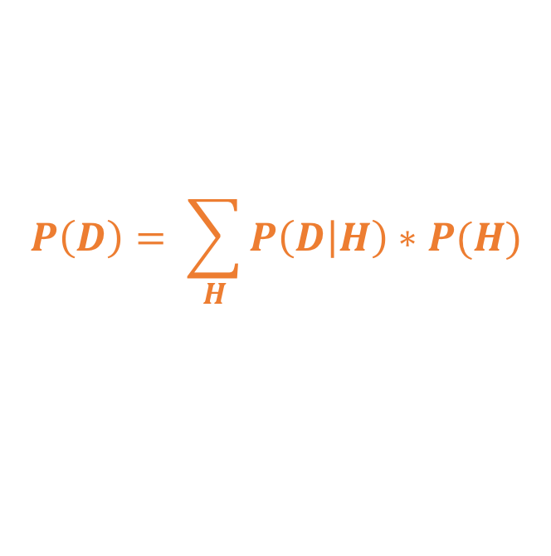
Bayesian stats example
$$P\left(+ | T\right)= \frac{0.99 ∗0.001}{P(T)}$$
Marginal likelihood:
$$P\left(D\right)= \sum_{H}{P\left(D | H\right)∗P(H)}$$

Slide 21

Bayesian stats example
$$P\left(D\right)= \sum_{H}{P\left(D | H\right)∗P(H)}$$
This is the sum of P(H)*P(D|H) for all hypotheses (i.e. all values of H)

Slide 22
Bayesian stats example
$$P\left(D\right)= \sum_{H}{P\left(D | H\right)∗P(H)}$$
This is the sum of P(H)*P(D|H) for all hypotheses (i.e. all values of H)
There are only two hypotheses: Having disease (+) or not (-), so:
$P\left(D\right)=\left[P\left(T | +\right)P\left(+\right)\right]+$ $\left[P\left(T | −\right)P(−)\right]$

Slide 23
Bayesian stats example
Prob of testing positive given that you have the disease (0.99)
$P\left(D\right)=\left[P\left(T | +\right)P\left(+\right)\right]+$ $\left[P\left(T | −\right)P(−)\right]$
Prob of having the disease (=0.001)

Slide 24
Bayesian stats example
Prob of testing positive given that you have the disease (0.99)
$P\left(D\right)=\left[0.99∗0.001\right]+$ $\left[P\left(T | −\right)P(−)\right]$
Prob of having the disease (=0.001)

Slide 25
Bayesian stats example
Prob of testing positive given that you don’t have the disease (i.e. probability of a false positive) = 1%
$P\left(D\right)=\left[0.99∗0.001\right]+$ $\left[P\left(T | −\right)P(−)\right]$
Prob of not having the disease
0.01% of population have disease
so 99.99% don’t

Slide 26
Bayesian stats example
Prob of testing positive given that you don’t have the disease (i.e. probability of a false positive) = 1%
$P\left(D\right)=\left[0.99∗0.001\right]+$ $\left[0.01∗.999\right]$
Prob of not having the disease
0.1% of population have disease
so 99.9% don’t

Slide 27

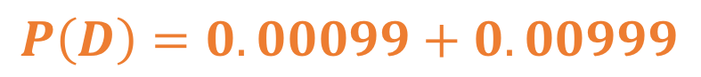
Bayesian stats example
Doing some math…
$P\left(D\right)=0.00099+$ $0.00999$
$$P\left(D\right)=0.01098$$

Slide 28

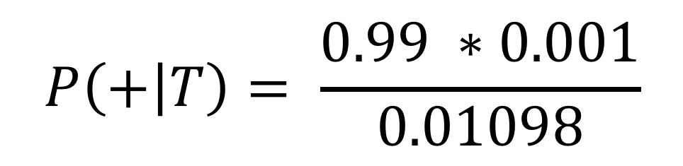
Bayesian stats example
$$P\left(+ | T\right)= \frac{0.99 ∗0.001}{0.01098}$$
$$P\left(+ | T\right)=0.09$$
~10% probability you have the disease, given that you have tested positive

Slide 29
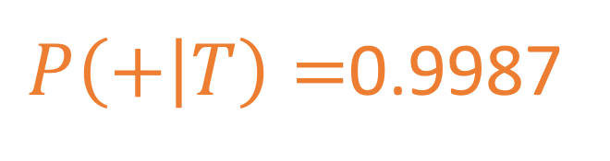
Bayesian stats example
Why?
Relatively high false positive rate
Disease extremely rare
With more realistic numbers: HIV in U.S
HIV test ~0.0004% false positive rate
0.3% of US population has HIV
$P\left(+ | T\right)=$0.9987

Slide 30
The power of priors!
By incorporating prior knowledge, we can:
Incorporate additional information
Make our assumptions explicit

Slide 31
The power of priors!
BUT, we can also:
Dominate the posterior probability when there is little signal in our data
Bias the result when we mis-specify our priors
Over-express our confidence in our prior expectations
Make reviewers mad

Slide 32
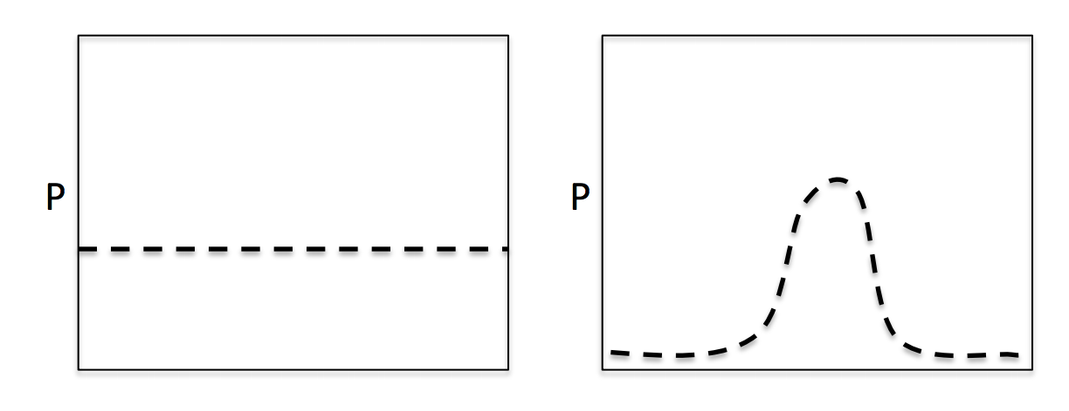
Priors in practice
BUT, we can also:
Often are provided as distributions
Can be informative or uninformative (reflecting how much we know)

Slide 33
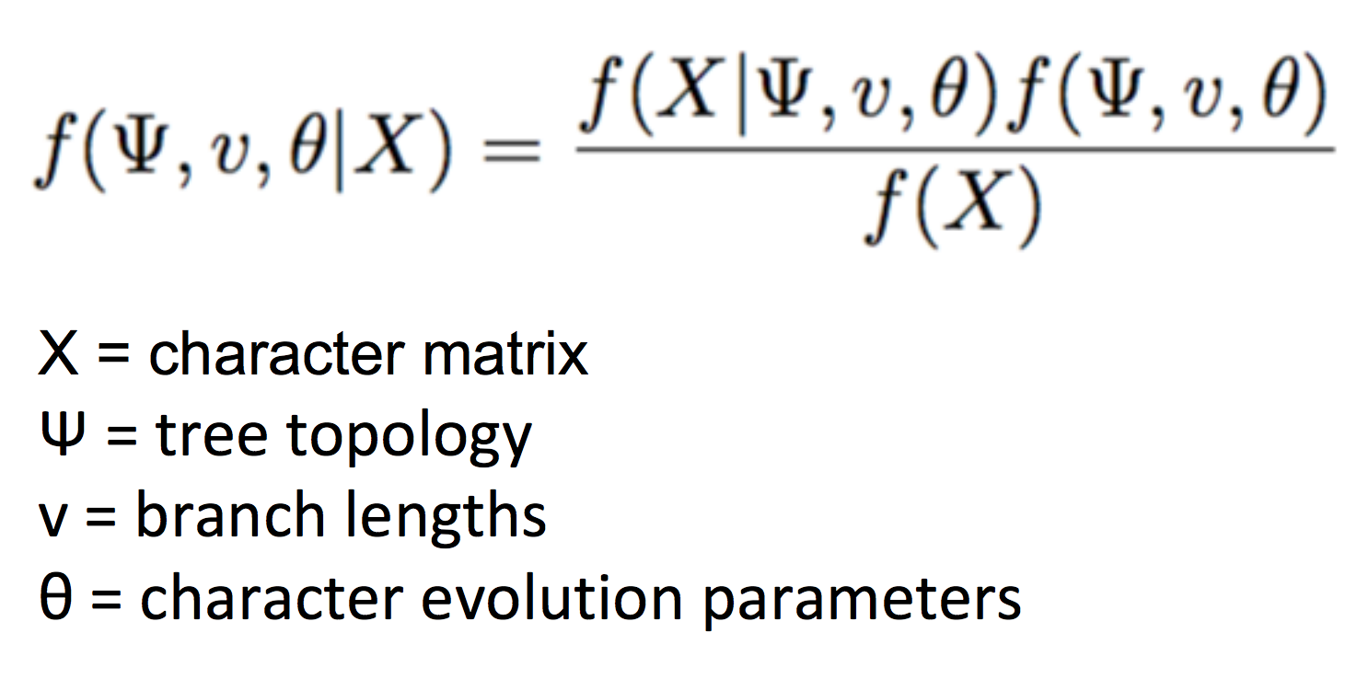
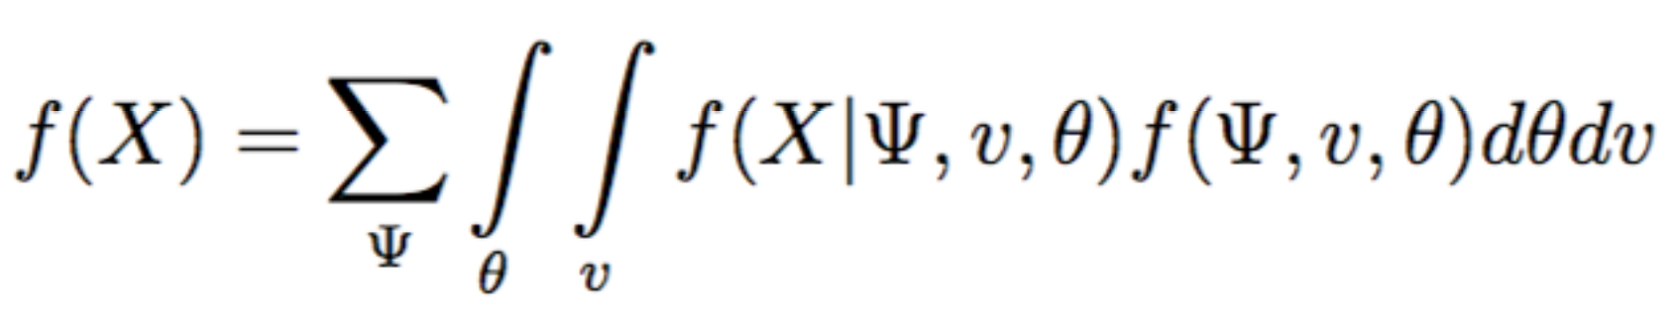
Bayes Theorem in Phylogenetics

Slide 34
Bayes Theorem in Phylogenetics
Pretty complicated…
We can’t directly solve this analytically
Instead, we model it as a probability distribution
To do this, we use a method called Markov Chain Monte Carlo

Slide 35
Markov Chain Monte Carlo (MCMC)
Family of sampling algorithms used to approximate a probability distribution
Simulates a “walk” through parameter space
Markov chain = A memoryless process
Monte Carlo = simulation based on random sampling

Slide 36
MCMC Method
Start at some value for parameter 𝜃
Sample a new value 𝜃’ (from a prior!)
Calculate probability ratio (R)
If R >= 1: Keep new value 𝜃’
If R < 1, draw a random number 0≤𝛼≤1. If 𝛼 > R, throw away 𝜃’
Return to step 2 for next iteration
Repeat a few hundred thousand times…

Slide 37
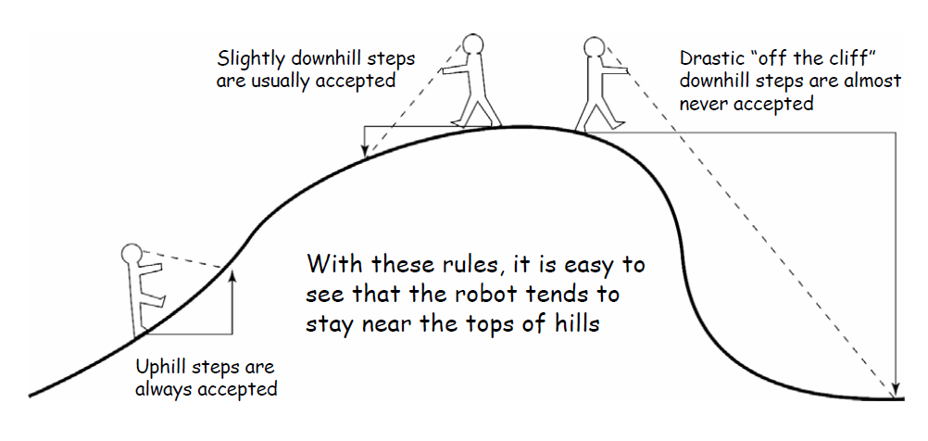
MCMC “Robot” Metaphor

Slide 38
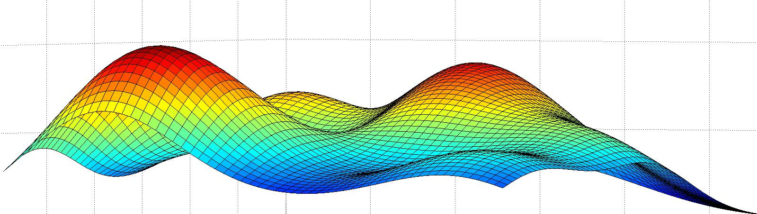
Sampling parameter space
Different starting points can lead to different answers
MCMC “chain” can get stuck on local peaks
Hopefully this sounds familiar

Slide 39
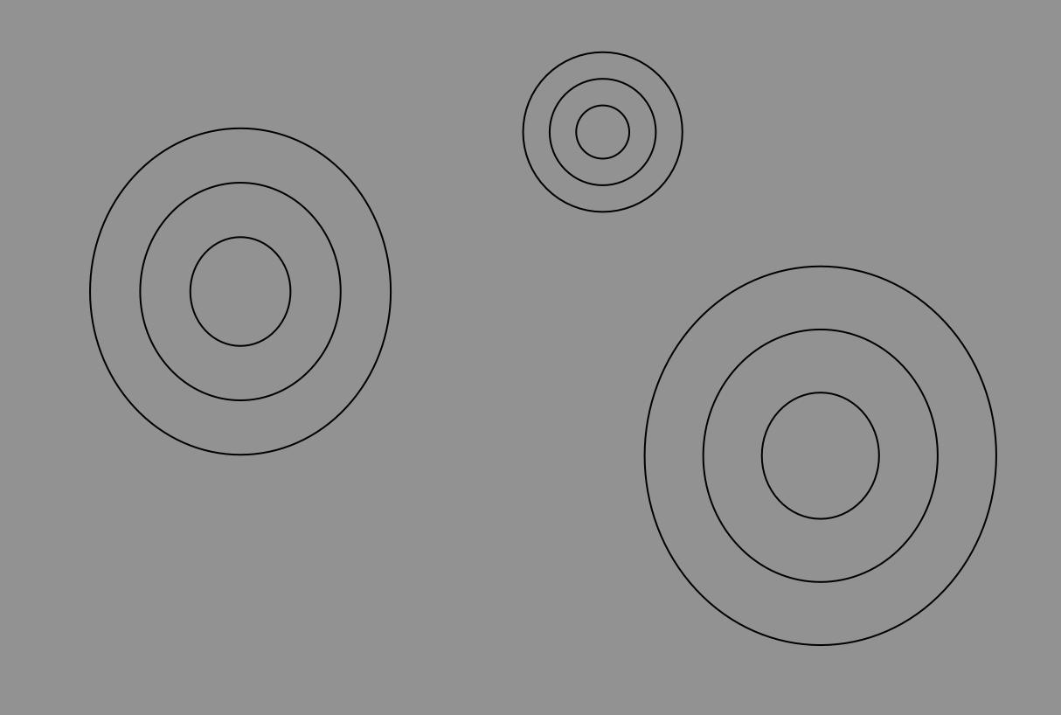

Slide 40
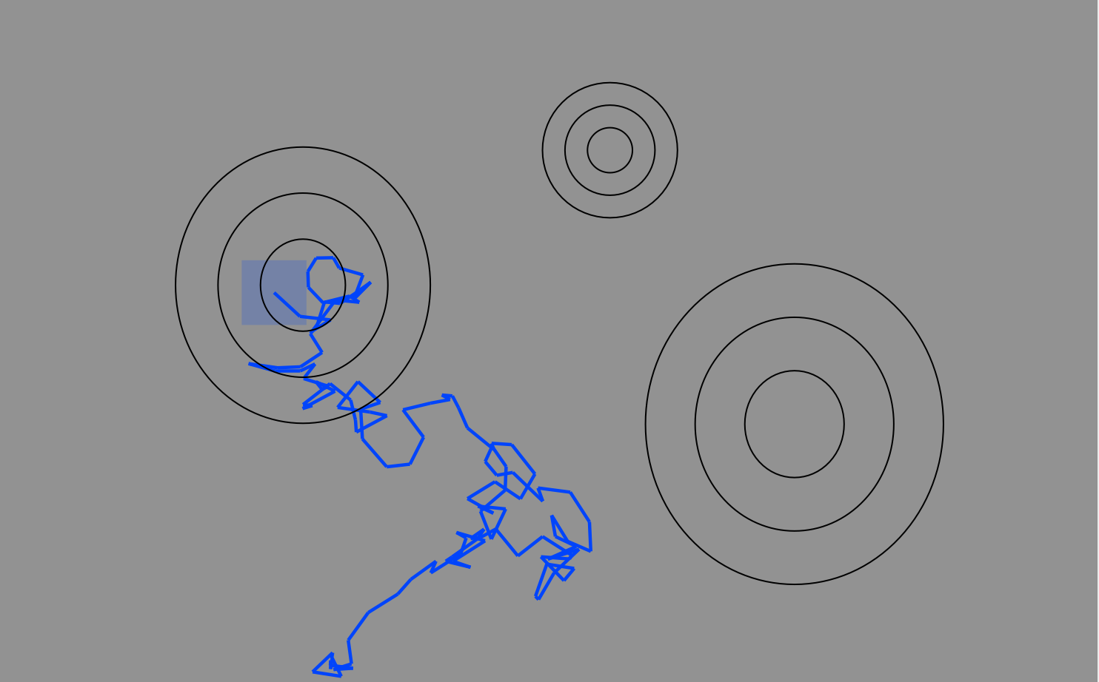
It sometimes takes a while for the “MCMC Robot” to find the hill to climb… These samples likely do not approximate the posterior, so we discard them as “burn-in”

Slide 41
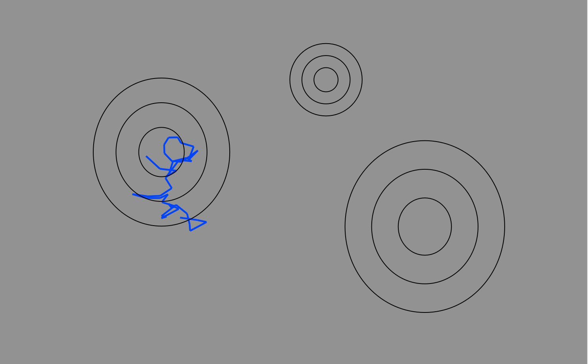
It sometimes takes a while for the “MCMC Robot” to find the hill to climb… These samples likely do not approximate the posterior, so we discard them as “burn-in”

Slide 42
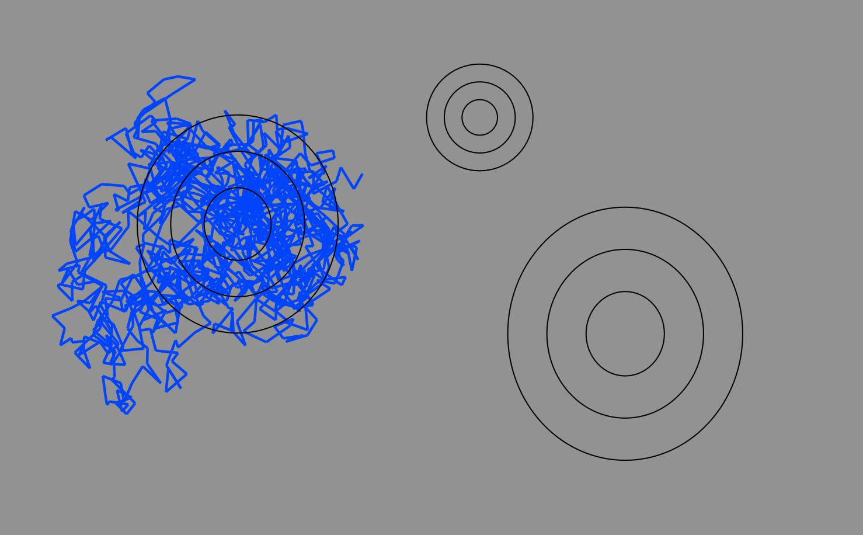
Continued sampling explores peaks in parameter space.

Slide 43
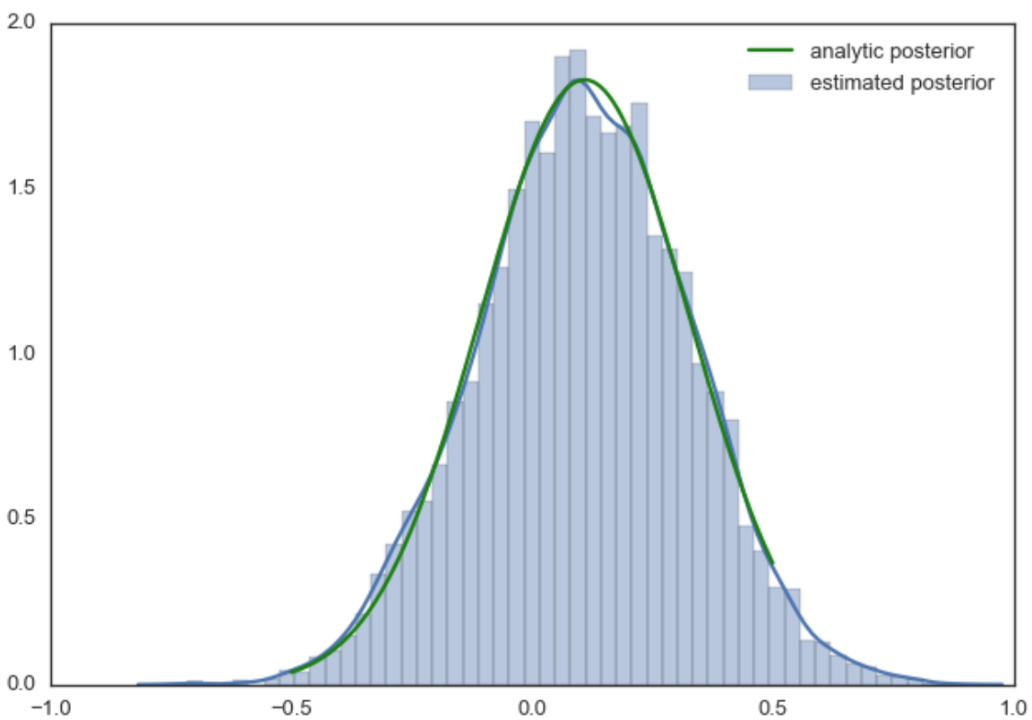
The ‘samples’ taken from these data points is assumed to approximate the posterior, giving us a distribution of results proportional to the posterior probability distribution.

Slide 44
Oh no! We’re stuck on a local optimum! What about the rest of parameter space??

Slide 45
Metroupolis-coupled MCMC
Adds additional chains which act as “scouts”
Scouts (called “heated” chains) explore a flattened landscape
Occasionally (e.g. every 1000 iterations), we check if heated chains found a better peak. If yes, they swap states

Slide 46
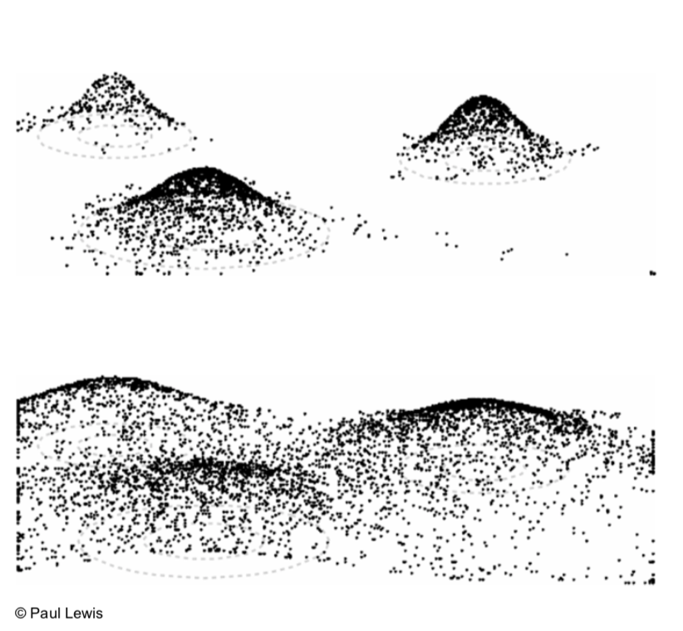
Metroupolis-coupled MCMC
Cold landscape: Peaks separated by deep valleys- hard for hill climbing robot to cross
Heated landscape: Flattened and shallow (easy to cross) valleys

Slide 47
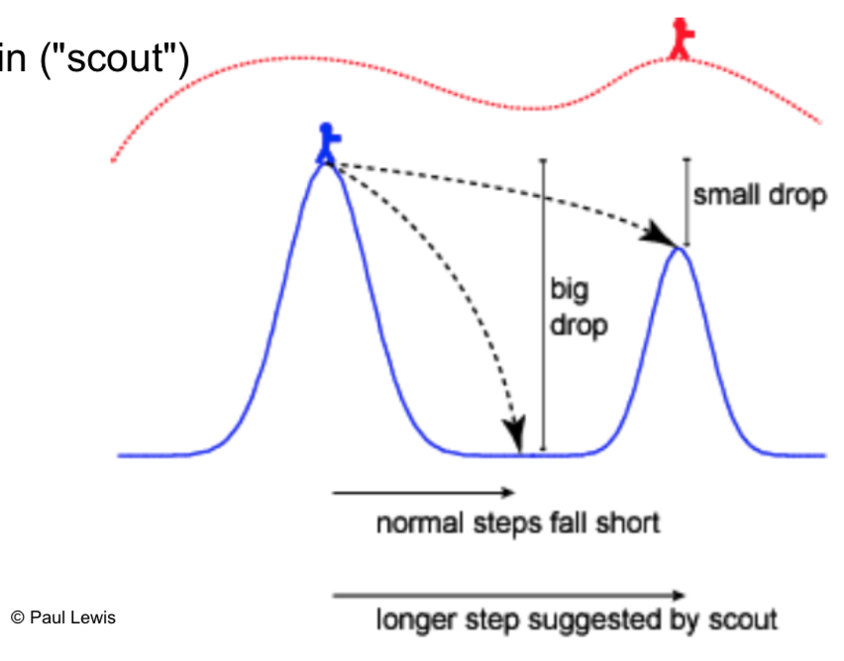
Metroupolis-coupled MCMC

Slide 48
Assessing MCMC Sampling
Burn-in
Throw out samples taken prior to convergence
Convergence = sampling approximately around the same point
Mixing
How efficient is your sampling – is the chain stuck sampling the same place for long periods of time?
Consistency
Are independent runs finding the same result?

Slide 49
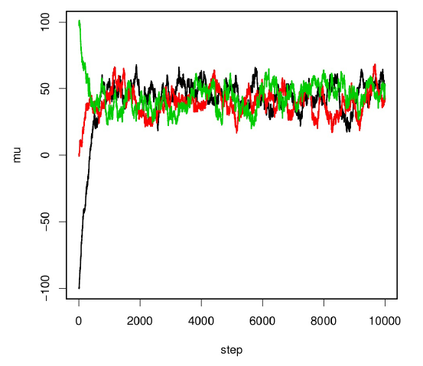
Assessing MCMC Sampling
Remove trees sampled while chain is trying to “find” regions of high probability
This is “burn-in”

Slide 50
Assessing MCMC Sampling
Burn-in
Throw out samples taken prior to convergence
Convergence = sampling approximately around the same point
Mixing
How efficient is your sampling – is the chain stuck sampling the same place for long periods of time?
Consistency
Are independent runs finding the same result?

Slide 51
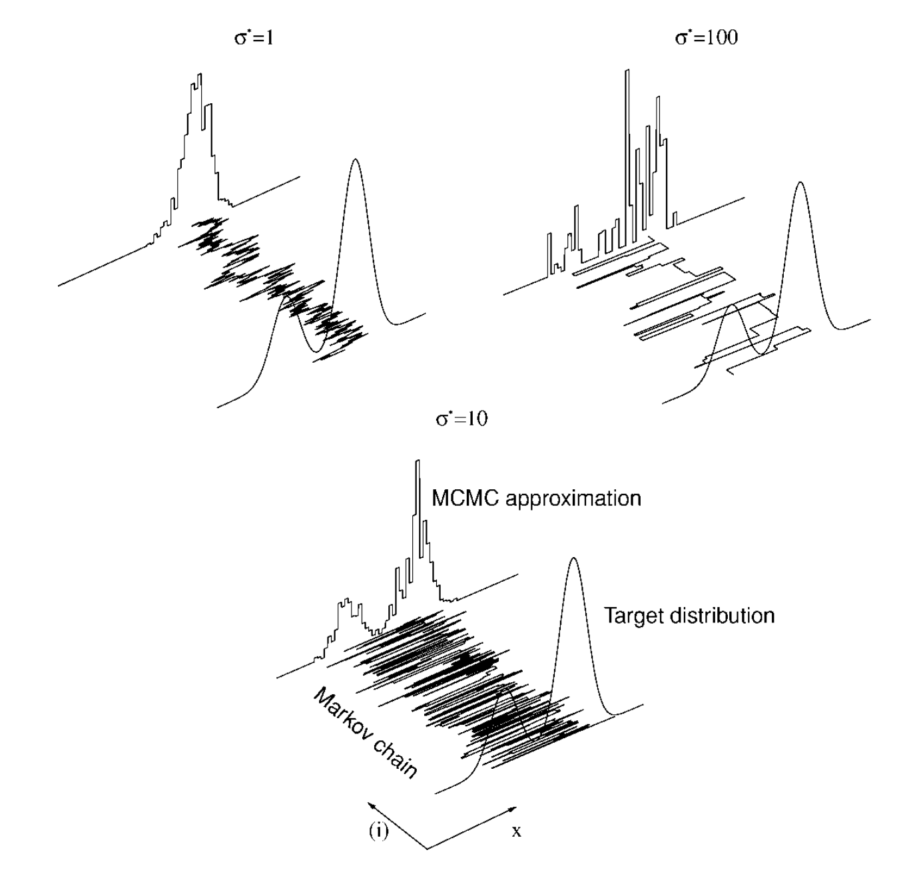
Assessing MCMC Sampling
Do our samplings approximate the posterior?
Stuck sampling the same place for a long time?
Bouncing around too erratically?

Slide 52
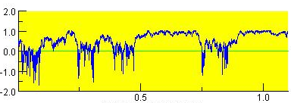
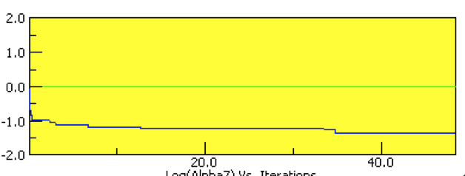
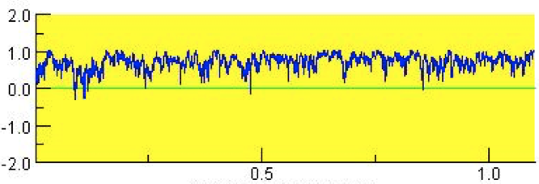
Assessing MCMC Sampling
Bouncing around erratically! 🤬
Stuck in the same place! 🤬
Good mixing 😀

Slide 53
What to do about bad mixing?
Adjust “step size”, or how different proposed steps are.
Proposed steps can’t be too similar or too different
Felsenstein: “At the moment the choice of a good proposal distribution involves the burning of incense, casting of chicken bones, use of magical incantations, and invoking the opinions of more prestigious colleagues.
Thinning samples
For example, only record every 1,000th three instead of every 100th
Will need to run MCMC longer..

Slide 54
Assessing MCMC Sampling
Burn-in
Throw out samples taken prior to convergence
Convergence = sampling approximately around the same point
Mixing
How efficient is your sampling – is the chain stuck sampling the same place for long periods of time?
Consistency
Are independent runs finding the same result?

Slide 55
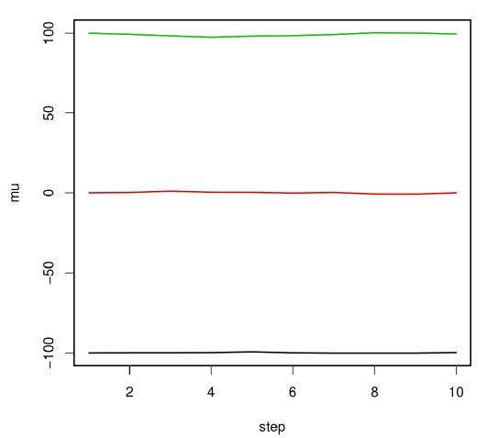
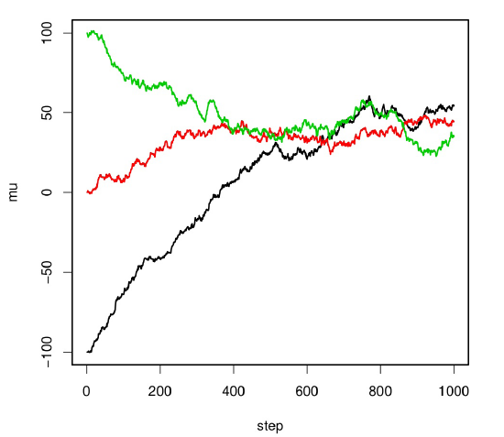
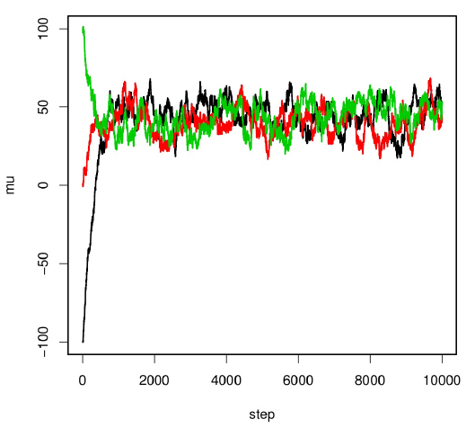
Convergence
Use different starting points (trees)
MrBayes takes care of this for you…
If independent runs produce consistent results, your chains have probably reached convergence

Slide 56
What now??

Slide 57
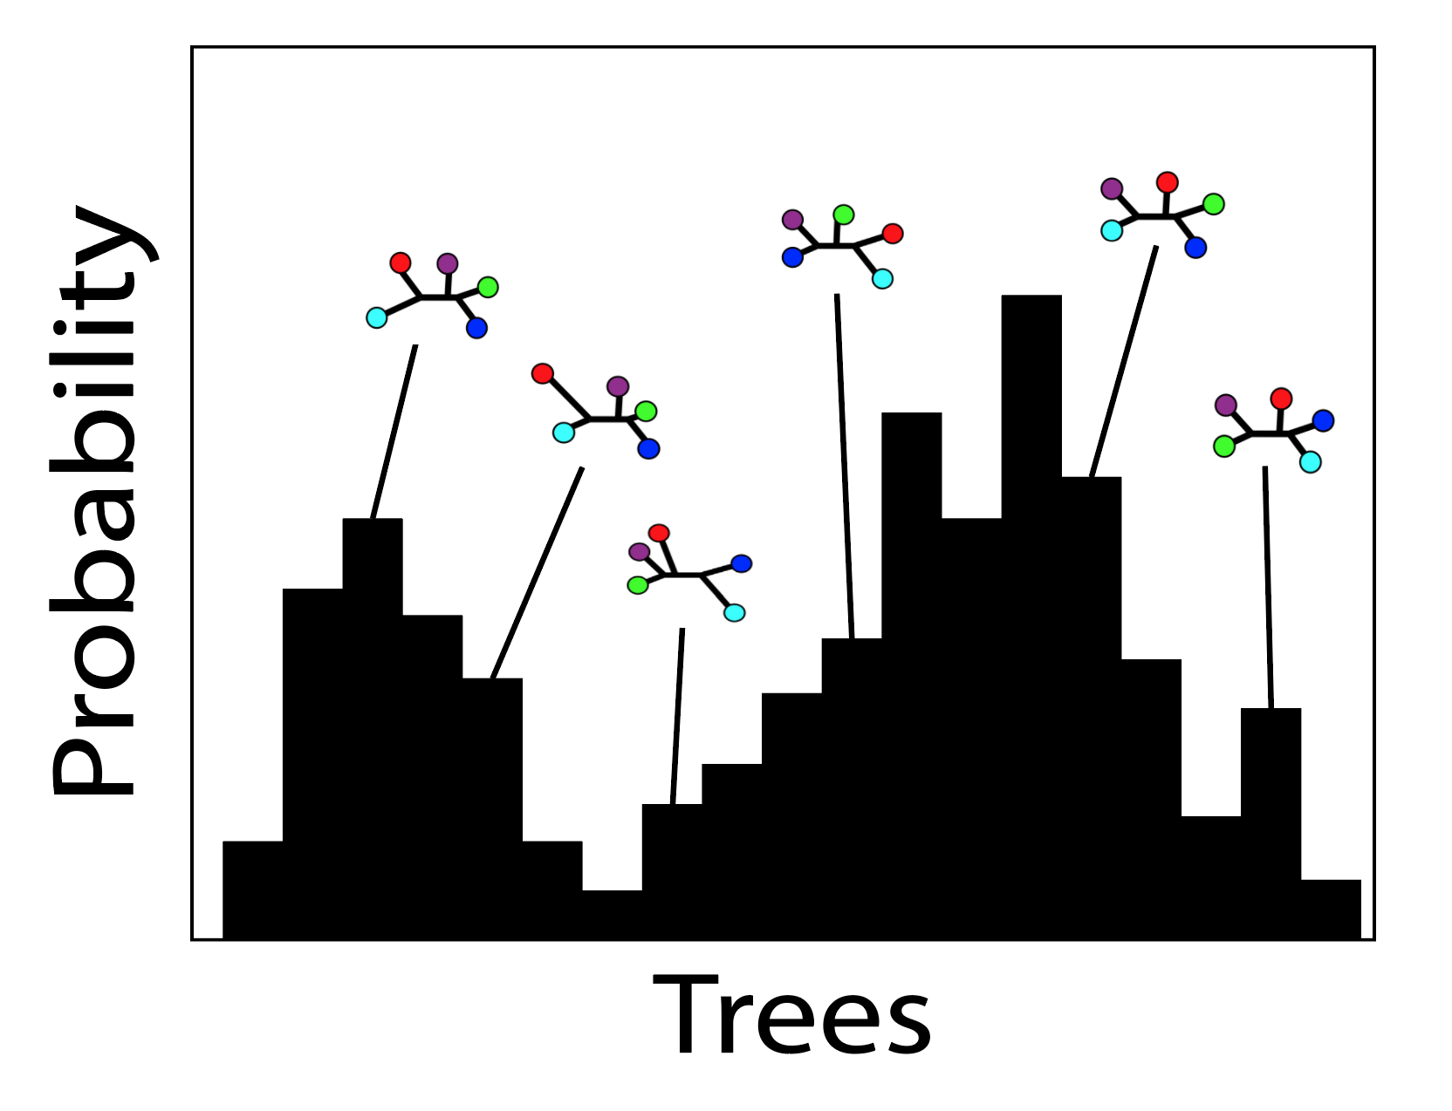
Result: A distribution of trees

Slide 58
Summarizing the distribution
87
99
98
100
Node supports represent posterior probabilities: How many posterior trees agree with that node?

Slide 59
MrBayes – Basic Work Flow
Set up short exploratory analyses to:
Determine burn-in
Assess convergence
Set up the “real” analysis using results of your exploratory analyses
Run for a much longer period of time
Potentially a million or more generations
Double-check that convergence occurred
Go back to the drawing board as necessary

